Slide 1
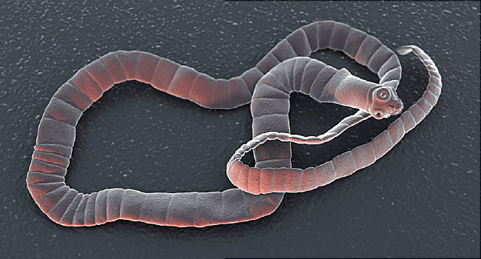
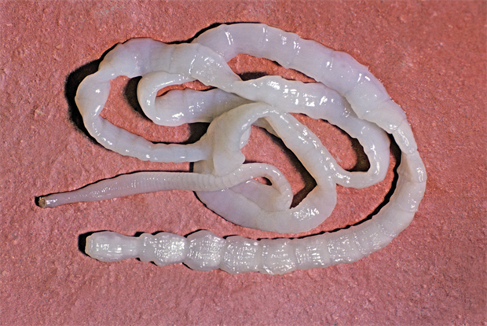
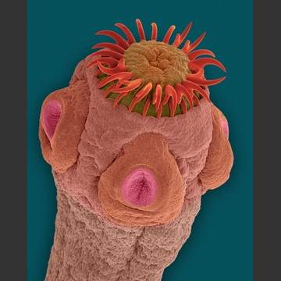
Class: Cestoda (Tape Worm) الديدان الشريطية
General characteristics
All species are parasitic.
Flat-segmented body, various length, few mm to several meters
No digestive system, cuticle of the body has pores in which nutrients is absorbed.
Excretory and nervous systems are present

Slide 2
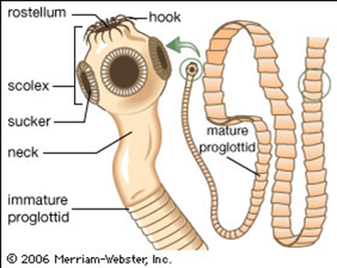
Body consist 3 regions:
  scolex: suckers (grooves), muscular suckers
(acetabula, cup shape) or hooks (armed)
B- Neck: germinal portion
C- Strobila: immature, mature, gravid proglottid
All are hermaphrodite, each segment has developed reproductive system (male & female).

Slide 3
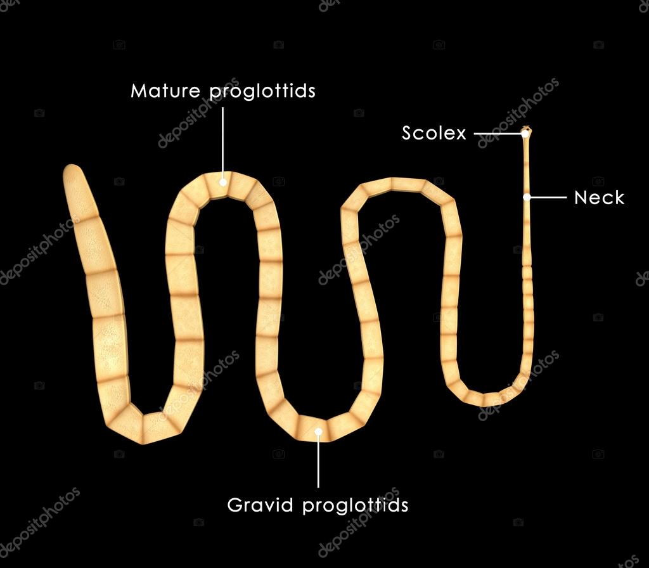
Taenia solium
Common name/location: pork or armed tapeworm/small intestine of human.
Length: 2-7 meters.
Proglottids no. 800-900.
Disease: Taeniasis

Slide 4
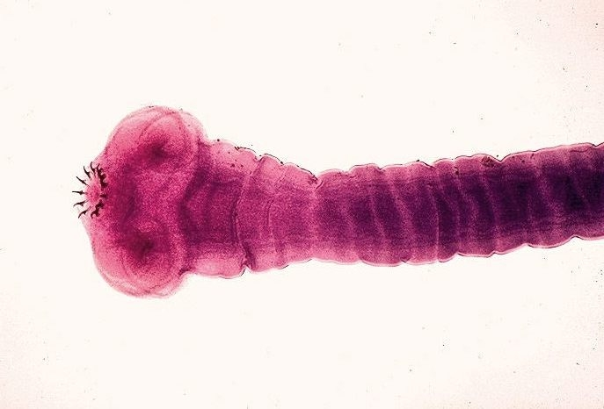
Infective stage: Cysticercus cellulose
Intermediate host: muscle of pigs.
Distribution: Teniasis and cysticercosis occur worldwide but is endemic in areas of Asia, South America, and eastern Europe .
Morphology T. solium can be identified by its scolex with 4 suckers and circle of hooks by its gravid proglottids, which have 7-12 primary uterine branches. Larva of T.solium called cysticercus. A cysticercus consist of a pea-sized fluid-filled bladder with an invaginated scolex.
Diagnosis: ova in stool.

Slide 5
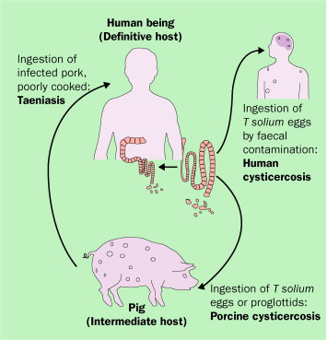
Life Cycle of T. solium

Slide 6
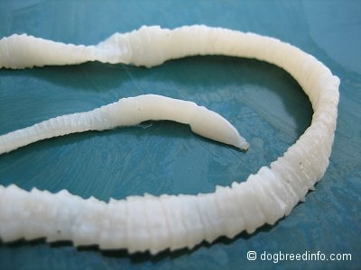
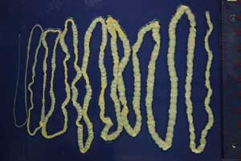
Taenia saginata
Common name/location: beef or un-armed tapeworm/small intestine of human.
Length: up to 25 meters.
Proglottids no. 1000-2000.

Slide 7
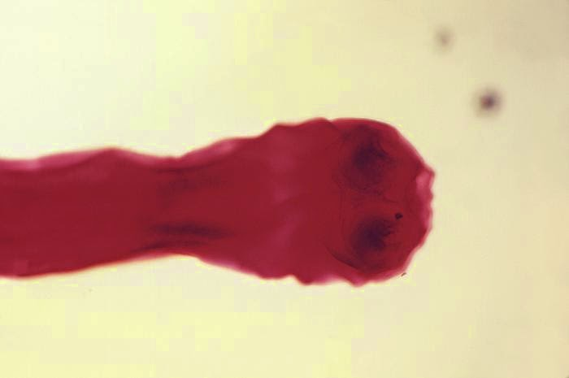
Distribution: occur worldwide but is endemic in areas of Asia, South America, and eastern Europe
Disease: Taeniasis
Infective stage: Cysticercus bovis
Intermediate host: muscle of cows
Morphology. T. saginata can be identified by its scolex with 4 suckers without hooklets. Its gravid proglottids have 17-35 primary uterine branches. Larva of T.saginata called cysticercus.
Diagnosis: ova in stool
Transmittion: fecal-oral
Laboratory diagnosis: gravid proglottids (with 17-35 uterine branches) may be found in the stools.
Prevention. Prevention of taeniasis saginata involves cooking beef adequately and preventing cattle from ingesting human feces by disposing of waste properly.
Clinical manifestation of teniasis soleum and teniasis saginata: abdominal pain, nausea, diarrhea, weight loss, infection may by asymptomatic

Slide 8
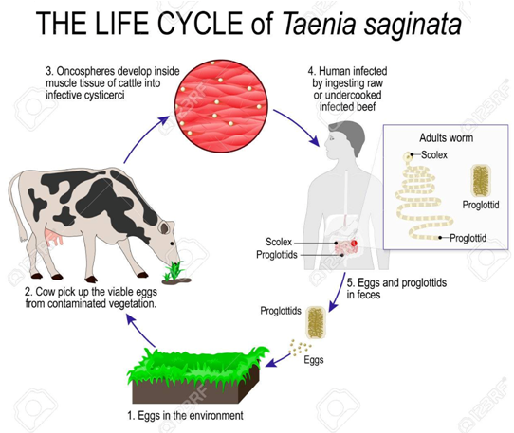

Slide 9
Echinococcus granulosus (dog tapeworm)
Common name/Location: Hydatid tapeworm الشريطية العدرية/ small intestine of carnivorous mammals.
No. of proglottids: 3
Intermediate host: livestock (ماشية) and human.
Final host: carnivorous (dogs, fox etc.)
Infective stage of intermediate host: egg
Infective stage of final host: hydatid cyst الكيس المائي
Disease: Hydatid cyst (Echinococcosis)
Distribution: is found in northern Europe, Siberia, Canada, the USA.
Morphology. Worm is up to 3-5 mm. Scolex has suckers and hooks. A neck is short. Strobila has 3-5 proglottides. Posterior segment (mature) is the largest and contains uterus with the haustrums, genital pore situated in the back of the proglottid.
Transmission: fecal-oral

Slide 10
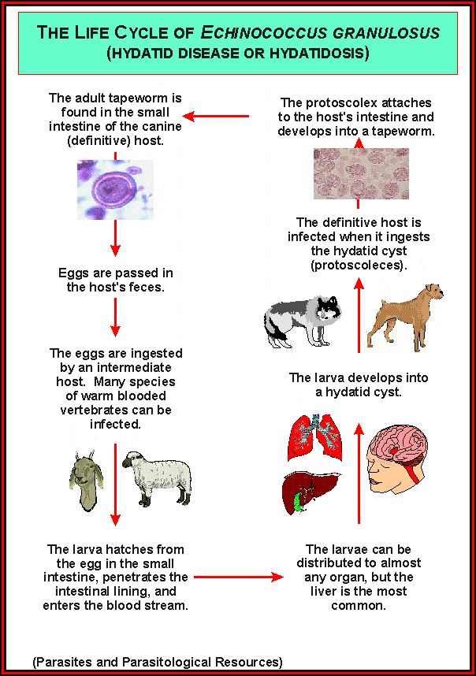

Slide 11
Clinical manifestations. asymptomatic, but liver cysts may cause hepatic dysfunction. Cysts in the lungs can erode into a bronchus, causing bloody sputum; end cerebral cysts can cause headache and focal neurologic sings.
Diagnosis: X-ray, Ultrasound.
Prevention of human disease involves not feeding the entrails of slaughtered sheep to dogs.

